Slide 1
Reflection
Looking inside yourself
Programming – Introduction to C#
Last modified 12/12/16 by Alex Mackay

Slide 2
Contents
What is reflection?
Diagrams
Equations
Code Samples

Slide 3
What is Reflection?
Reflection is the ability of a language to read its own metadata
You can fetch type information at runtime programmatically
Allows dynamic loading of assemblies compiled for other platforms
Notes:
Metadata is an abstract binary representation of your program
Uses the metadata generated by the program, typically extracted from its assembly
Can be problematic because you have access to everything within the class
You can even add and remove methods, variables, fields and properties
Most notably, you can execute methods
Can be used in factories to look at the methods and members of a type and creating things based on that type, rather than relying on an enumeration Downside to dynamically loading in libraries is that any dependencies must be loaded in manually

Slide 4
Objects and Types
Everything in C# is an Object (Class), both predefined and user defined
All data types directly or indirectly inherit from the Object class
We will be using Object types later
The type class represents all type declarations
Allows access to metadata for Reflection

Slide 5
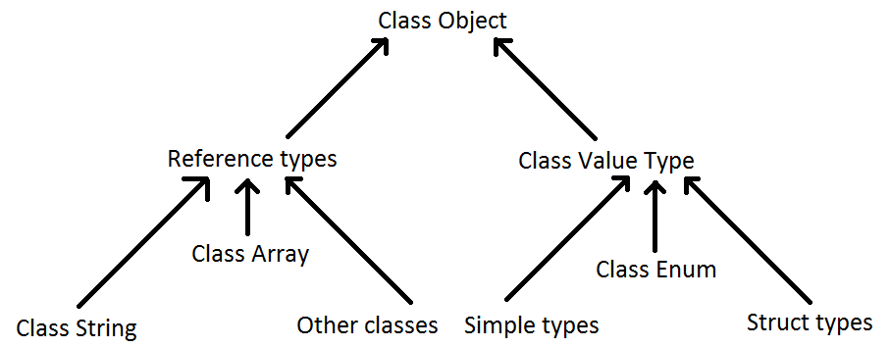
Overall class hierarchy from C#

Slide 6
The Type Class
Primary way to get access to metadata of a type
Includes classes, structures, enumerations, interfaces, delegates
Describes how types are declared, used and managed in the common language runtime
Above, t contains information about the Car class, all the members and members inside the class
Car c = new Car();
Type t = c.GetType();

Slide 7
Getting Type Information
There are three main ways:
System.Object.GetType()
System.Type.GetType()
C# Operator typeof

Slide 8
C# Operator Typeof
The simplest way to get Type information
Similar to C++ typeof
The variable t now contains information about the Type that Car is
Type t = typeof(Car);

Slide 9
System.Object.GetType()
This method gets an instance of an object to report what Type it is
Need to have knowledge of the type beforehand
Car c = new Car();
Type t = c.GetType();

Slide 10
System.Type.GetType()
Has a few overloads, check MSDN for further information about what each does
One specific overload takes in a string of the class name, a Boolean to specify case sensitivity and a Boolean to specify throwing exceptions for unknown types
Type t = Type.GetType("Reflection.Car", false, true);

Slide 11
What’s in the type class?
Broken down into Properties and Methods
Properties: A mechanism for reading and writing values, similar to getters and setters in C++, provides a simple way to get both get and set functionality

Slide 12
Properties of the Type class
Falls into three categories
Strings containing various names associated with the class
e.g. Name, FullName
Objects that the class is related to
e.g. BaseType, UnderlyingSystemType
Boolean properties
e.g. is the type abstract, a class, an array, a pointer, an enum, etc

Slide 13
Methods of the Type class
Otherwise known as functions, these are used to obtain details of the members of the class
Each method returns a different data type, but method names are good enough to give information on what they do
E.g. GetConstructor / GetConstructors return ConstructorInfo
Notes:
GetConstructor() and GetConstructors() - returning ConstructorInfo
GetEvent() and GetEvents() - returning EventInfo
GetField() and GetFields() - returning FieldInfo
GetInterface() and GetInterfaces() - returning InterfaceInfo
GetMember() and GetMembers() - return MemberInfo
GetMethod() and GetMethods() - return MethodInfo
GetProperty() and GetProperties() - return PropertyInfo

Slide 14
Using methods of the Type class
Can be used to get specific information about a type
GetMethod() returns a reference to a MethodInfo object containing information about a specific method
GetMethods() returns an array of MethodInfo objects containing information about all the methods within that type

Slide 15
Using methods of the Type class
Both methods have overloads to take in an extra parameter which specifies which members should be returned based on certain flags
For example:
Only return public methods that are static
Only return private methods that are not static

Slide 16
Example
Car c = new Car();
Type t = c.GetType();
MethodInfo carMethodInfo = t.GetMethod(“IsMoving”);
Console.WriteLine(carMethodInfo.Name);
MethodInfo[] carMethods = t.GetMethods();
foreach (MethodInfo mi in carMethods)
{
Console.WriteLine(mi.Name);
}
Notes:
Create a new Car c
Get a reference to the Type t by using the GetType method within c
Get a specific method by using the GetMethod within t and passing in a string of the specific method to retrieve
Print out the method name to the console
Get methods by using the GetMethods within t, saving it into carMethods
Loop through the array of MethodInfos and print out the names of each method

Slide 17
Fields and member variables
Interacting with constructors, events, fields, properties and members of a class are done in a similar way
Fields and member variables can be changed and manipulated at run time without ever knowing about the class type beforehand

Slide 18
Activator Class
Need to create an instance of the class that the method exists in
Contains methods to create types of objects locally
Use a string to create an instance of a type
CreateInstance method to instantiate a class

Slide 19
Activator Class
Type personType = typeof(Person);
object obj = Activator.CreateInstance(personType);
object[] personParams = new object[] { "JOHN SMITH", 222.0222f };
personType.InvokeMember("ChangeValues", BindingFlags.InvokeMethod, null, obj, personParams);
Notes:
It lets the programmer create an instance of an object from a string or a class type. It does so through the CreateInstance method. In the case above, it is used to instantiate a local object of type Person, with which you can use to invoke the methods of. The method being invoked is ChangeValues.
In order to specify argument types, an array of objects is created with the arguments listed. This will be used when the InvokeMember function is executed.
In order to invoke a method within an object, we use the Type variable that was created and call the InvokeMember function. This function takes in a few arguments. The first is the method name that exists within the object. The second parameter is used to specify method overloads with variable arguments. Passing in null as the argument uses the default binder. The fourth parameter is the object that method will be used on and the last parameter is the list of arguments that the method being invoked will be looking for.

Slide 20
Summary
We’ve only just scratched the surface of what Reflection really is and all it’s potential applications
Allows programmers to inspect libraries that are unknown to them
Reverse engineering of object hierarchy
Notes:
The topic of Reflection is very big, and this session covers the first few pages of the tome that could be written about reflection. It is a useful technique in inspecting the contents of an unknown object, allowing the programmer to determine the dependencies of a project, the object hierarchy of a program and a whole range of other things.

Slide 21
Further Reading
Microsoft, Reflection (C# and Visual Basic), MSDN
https://msdn.microsoft.com/en-us/library/ms173183.aspx

